Slide 1
Shell Bootcamp 2024 3 Reflections for Week 2
G Joshita Reddy
Date : 06-Sep-2024

Slide 2

About Me
Expand your horizons, don’t stay stuck in your comfort zone

Slide 3

My learnings from this week!

Slide 4
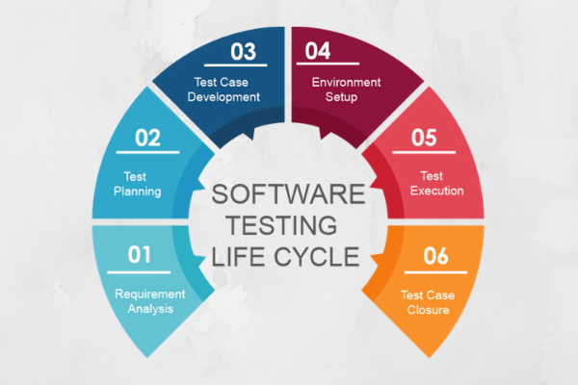
Learning 1 | My takeaways
Testing
Like SDLC, Software Testing Lifecyle plays an integral role as even a small bug/defect can crash the whole system. We learnt about various types of testing as well.
In a safety critical sector such as energy sector, where even a small mistake can have a huge impact, testing is valuable.
[Add a graphic that provides evidence of what you learned]

Slide 5

Learning 2 | My takeaways
GitHub
Learning about Git, version control software was very interesting. We learnt concepts such as commit, pull request, merge, reviewers etc.
Git & GitHub are quite important in any technology supporting energy sector as they can be used for collaboration and managing versions.

Slide 6
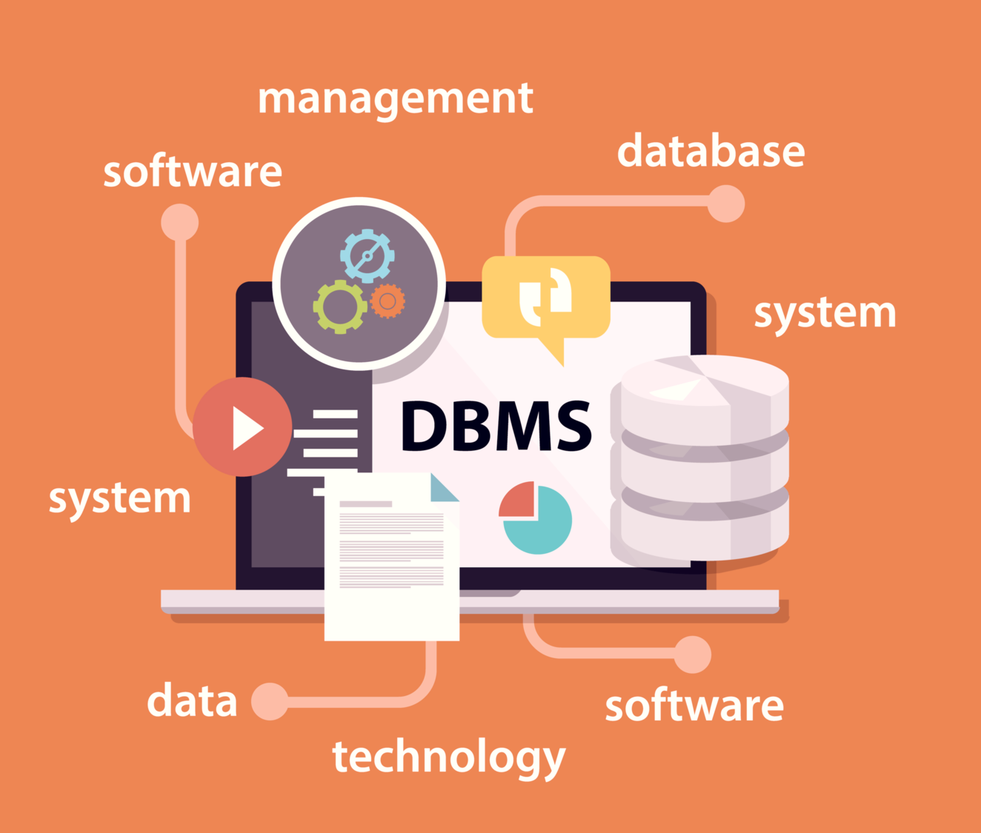
Learning 3 | My takeaways
Databases & DBMS
We reviewed DBMS concepts and executed Postgres SQL commands as part of hand-on activity.
Energy sector generates and deals huge amount of data, and it is quite important to manage it, hence, concepts like DBMS become quite important.

Slide 7

Relevance of learnings for my organization

Slide 8
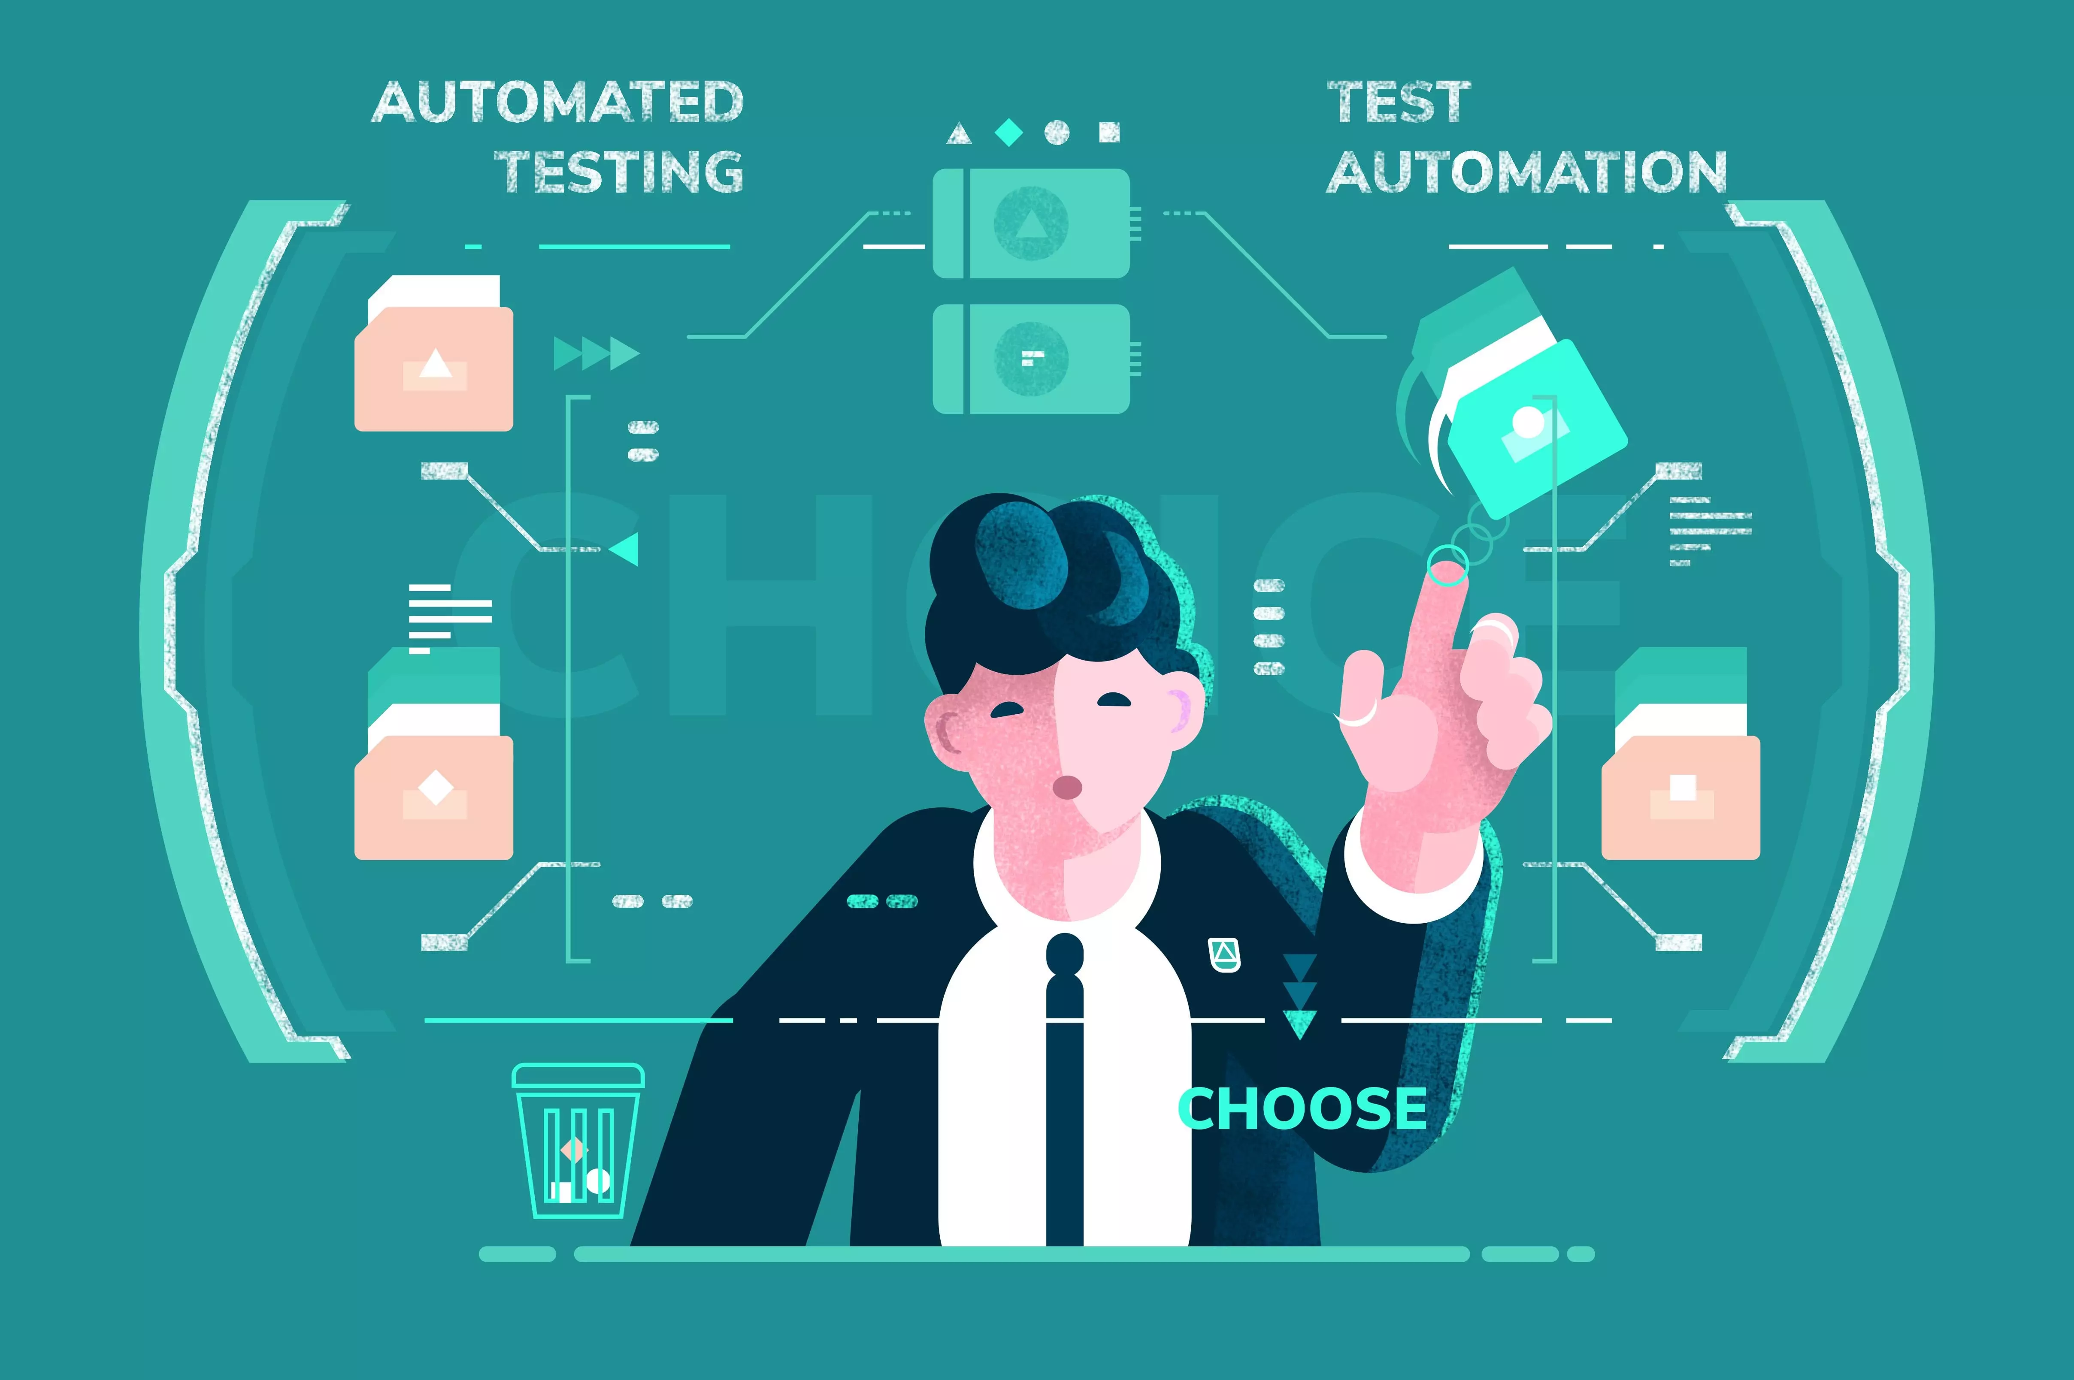
Learning 1 | Relevance for Shell
Understanding testing and its importance in a project for finding and fixing vulnerabilities helps promote a digitally safe environment.
Knowing about testing helps us identify any bugs or defects we find and fix them directly ourselves or indirectly by reporting to concerned authority.
[Add a graphic that provides view of how Shell implements this learning]

Slide 9
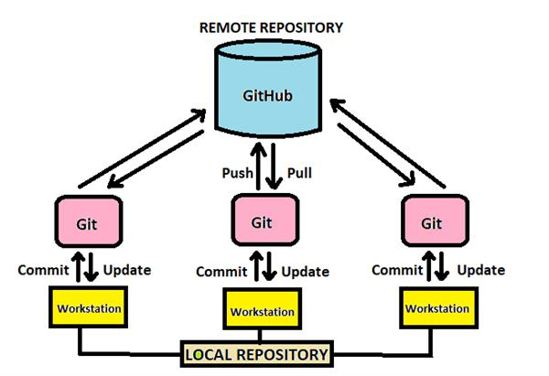
Learning 2 | Relevance for Shell
Version control software such as Git play an important role in any technical project in every sector, to manage new releases and fixing bugs.
It is important to be able to understand and work with GitHub for smooth operation and better collaboration.
[Add a graphic that provides view of how Shell implements this learning]

Slide 10

Learning 3 | Relevance for Shell
The digitalization of the world necessitates the need for managing the humongous amount of data generated everyday.
Understanding and being able to work with raw data and databases is an important skill to have, especially considering the considerable amount of digital footprint we leave everyday.
[Add a graphic that provides view of how Shell implements this learning]

Slide 11

Challenges in implementing learning

Slide 12

Challenge faced while implementing Learning 1
It was a bit hard to coordinate during Azure DevOps group activity to demonstrate testing, but active communication helped me.
https://dev.azure.com/Anvitha
[Add a graphic that provides evidence of what you did to overcome this challenge]

Slide 13
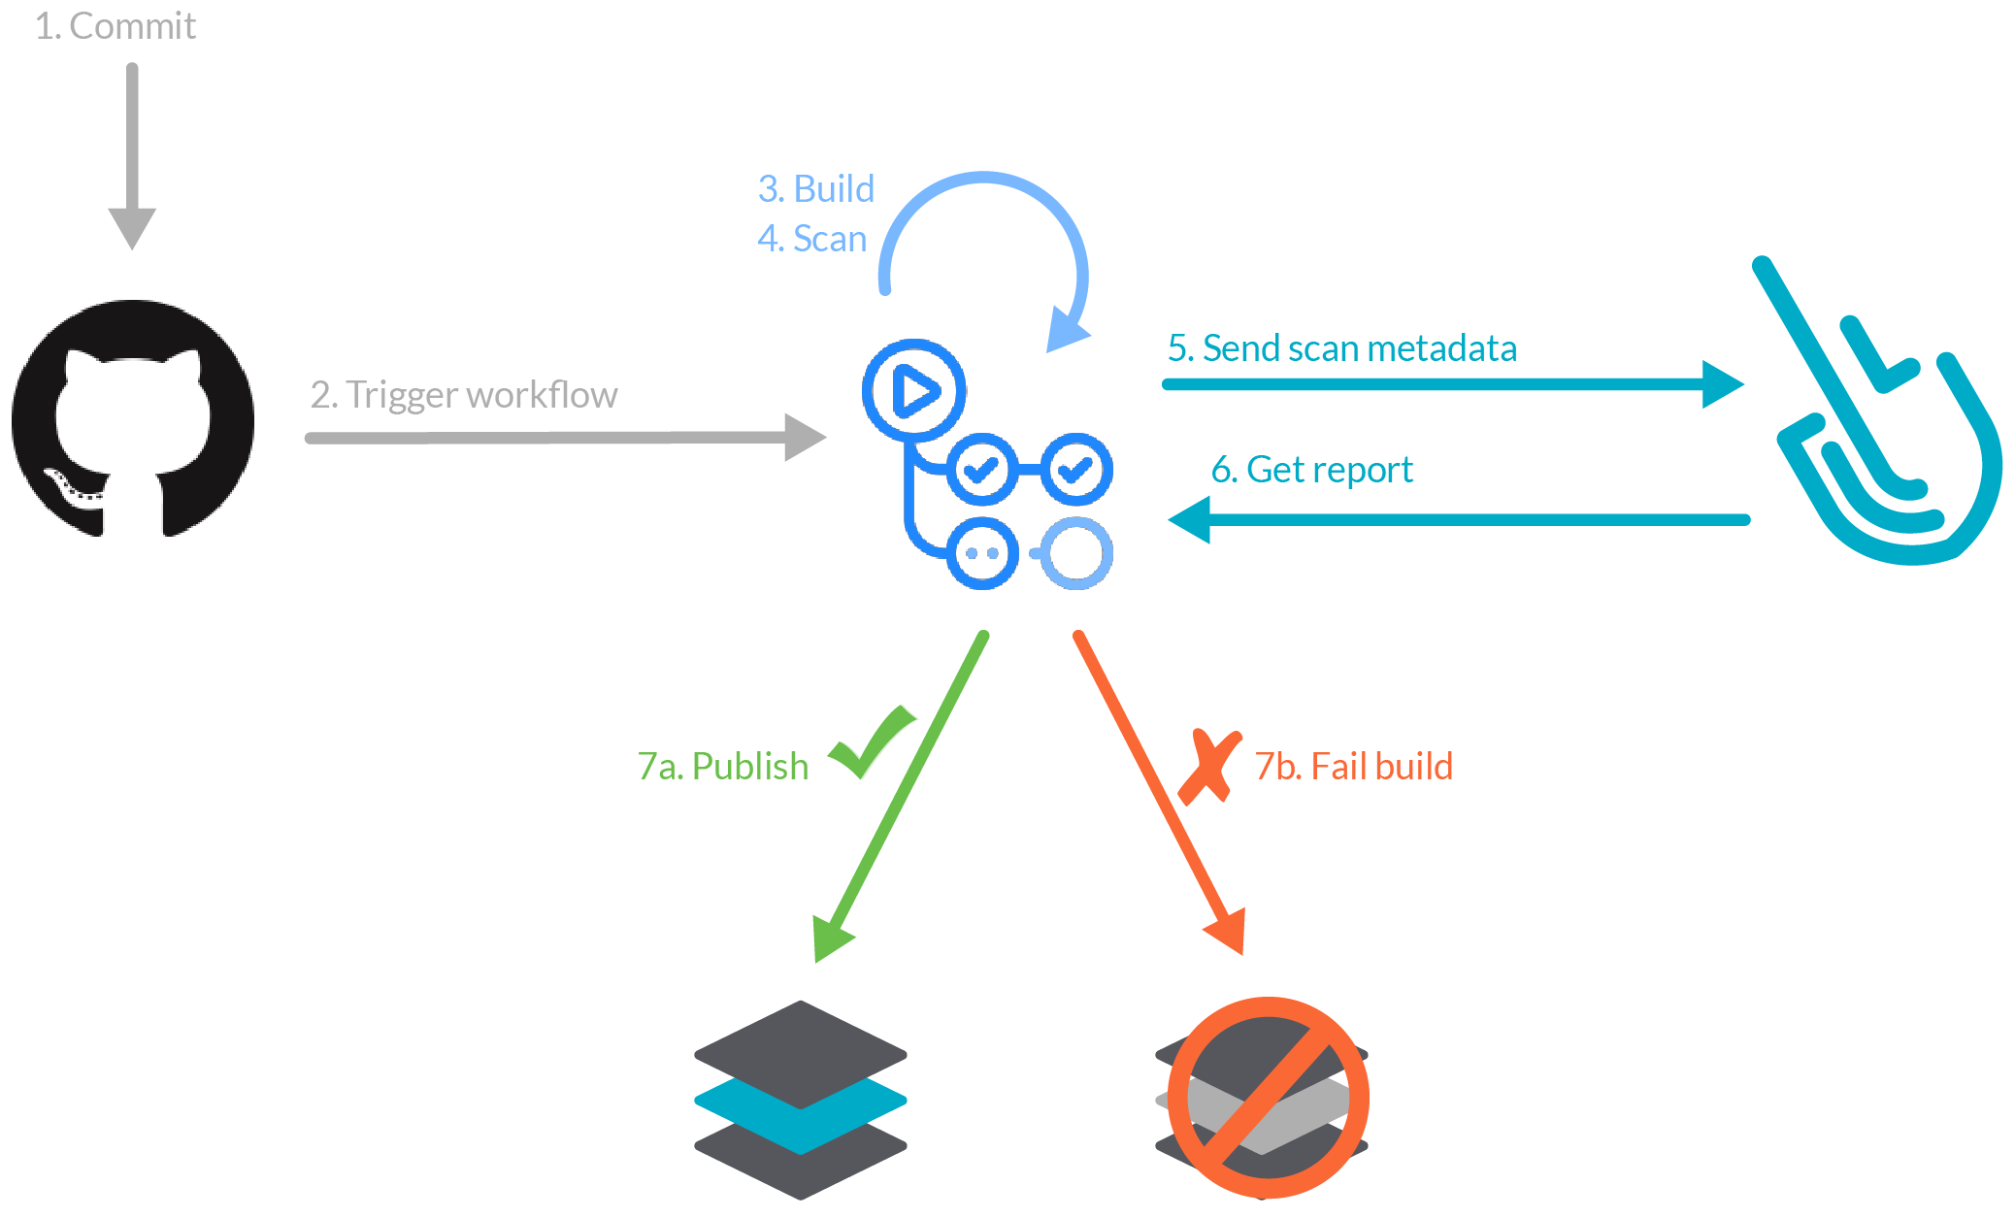
Challenge faced while implementing Learning 2
I faced error while deploying html page to GitHub Actions we created. It was resolved by going through all the performed steps & modifying and redeploying the page.
GitHub - JoshitaReddy/Foundational-Training
[Add a graphic that provides evidence of what you did to overcome this challenge]

Slide 14
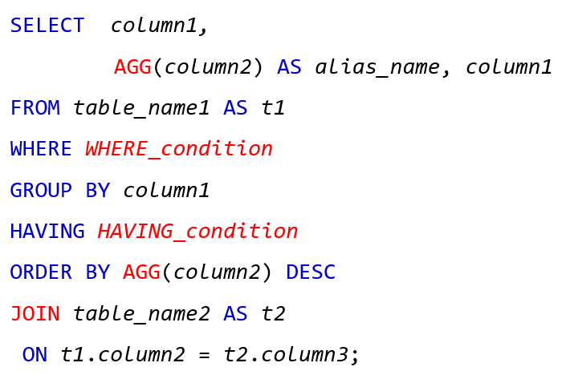
Challenge faced while implementing Learning 3
Writing SQL queries was slightly confusing, but it was easy to understand it as we progressed.
[Add a graphic that provides evidence of what you did to overcome this challenge]

Slide 15

Action Plan

Slide 16
My Action Plan for this Week
Actions
Timeline
Status
Learning more about new concepts I have been introduced to and experimenting with them.
Explore more about them during weekends & my free time.
Explored some concepts on an abstract level but yet to delve deep into them.

Slide 17

Learning is also Fun!

Slide 18
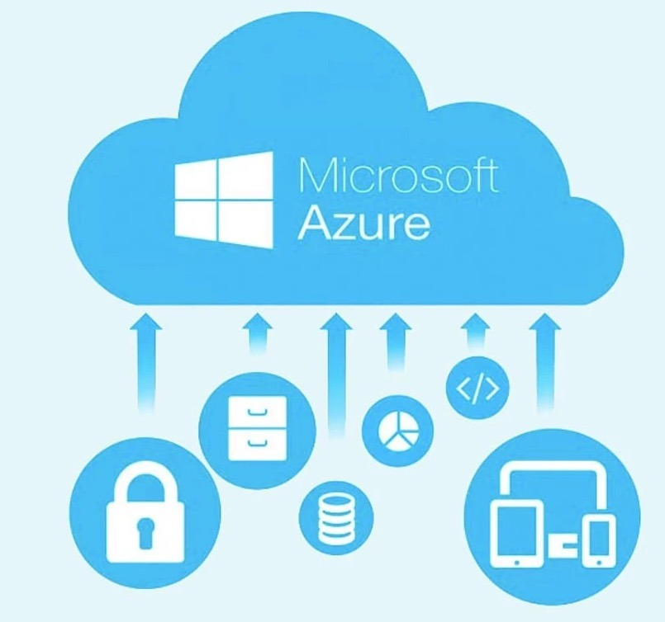
Learning is also Fun!
The hands-on sessions via individual and group activities on Azure DevOps, GitHub, creating a VM, writing SQL queries were quite fun.
Various case studied helped in development of better understanding of concepts.
]

Slide 19

Summary
Learnt about testing, cloud, DBMS and worked with various tools used such as PostgreSQL, Azure DevOps, Azure Cloud(Creating Virtual Machine), GitHub etc. for better understanding of concepts.
It is important to understand technical concepts and terminologies along with having basic hands-on experience on the tools which are used.

Slide 20
Thank You

